Slide 1

604 FINAL PROJECT PRESENTATION NYC FLIGHTS 2013
Team 1:
Showri Niharika Yeruva (VI29257)
Harshini Akkapally (RK84133)
Soumya Kasireddy (GH35538)

Slide 2
Dataset Contains information on…
Introduction
Process and Tools Used
What Can we Analyse?
Benefits to the Customers
Yearly Technical Cost Estimation
Entity Relationship Diagram
SQL Tables
Queries to Analyze Data using SQL
Tableau Visualization
Conclusion

Slide 3
Introduction
Flights Data Analysis:
In this project we aim to do analysis on Flights Dataset where we analyse all the domestic flights that took place in the NYC (EWR, JFK and LGA), United States in 2013 - 336,776 flights in total. This dataset has the detailed information on the number of on-time or delayed flights, flights from different origin or destination, flights of different carriers.
Each year, millions of travellers are affected by flight delays causing them to miss important meetings or miss connections and spend additional time away from home. Through this analysis we’ll try to explore what flights are more likely to be delayed.
Analysis of flights based on the location and time will be helpful to find which flights will arrive and depart from certain location and to find their schedule. At the same time, people can analyse shortest duration flight, find best airports in terms of early departure so they can book that flight and reach their destination on-time.

Slide 4
Dataset Contains information on…..
Key Columns in the Flights Data Set :
year, month, day : Date of departure.
dep_time , arr_time : Actual departure and arrival times (format HHMM or HMM)
sched_dep_time , sched_arr_time : Scheduled departure and arrival times (format HHMM or HMM)
dep_delay , arr_delay : Departure and arrival delays, in minutes. Negative times represent early departures/arrivals.
carrier : Two letter carrier abbreviation.
Flight : Flight number.

Slide 5
Dataset Contains information on…..
Tailnum : Identification number of an aircraft painted on its tail
Origin , dest : Origin and destination.
air_time : Amount of time spent in the air, in minutes.
Distance : Distance between airports, in miles.
hour, minute : Time of scheduled departure broken into hour and minutes.
time_hour : Scheduled date and hour of the flight as a POSIXct date

Slide 6



Process And Tools Used
AWS S3 Bucket: To load the flights_data.csv in the cloud storage and to store all the output files in the cloud
AWS RDS: To host the MySQL
AWS Glue: To access the data and create table definitions
AWS Athena: To analyze data in Amazon S3 using standard SQL
Tableau: For Visualization and Analysis

Slide 7
What can we Analyse?
Flights that travel from certain origin / destination
Flights that are operated by specific carriers
Arrival or Departure delays of flights from each carrier
Flights in each month from specific origin to destination for each carrier
Flights with shortest and longest airtime
Flights having arrival delay or departure delay more than certain time (in mins)
Which flight has the worst-on time record
Flights availability in specific month or days
Average arrival/departure delays of flights from origin to destination

Slide 8
Benefits to the Customers
Easily choose the Fastest Flights in Emergency Situations
Find the flights information from various Origins and the Destinations
Choose the carriers with minimum Delays, so they can save time in travel
Choose the best Flight with minimum duration
Choose which month has the more availability of flights to specific location
Can analyze which flights have the best on-time and worst on-time records, which helps them to decide the better carrier

Slide 9
Yearly Technical Cost Estimation
AWS Server and Storage costs: ~$35,000
DBMS Administrator Salary if hired- ~$80,000-90,000
Tableau: ~$1000

Slide 10
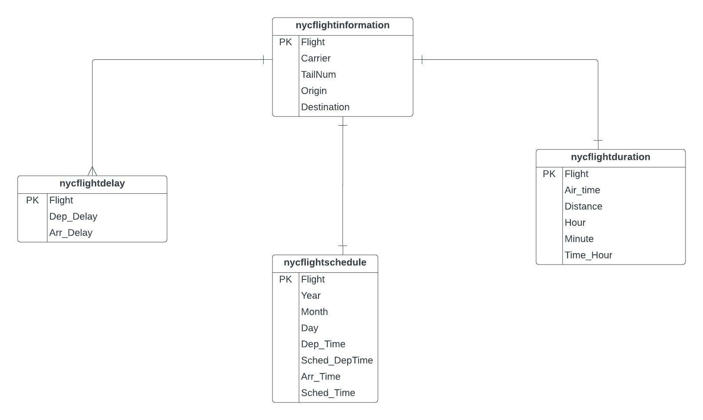
Entity Relationship Diagram

Slide 11
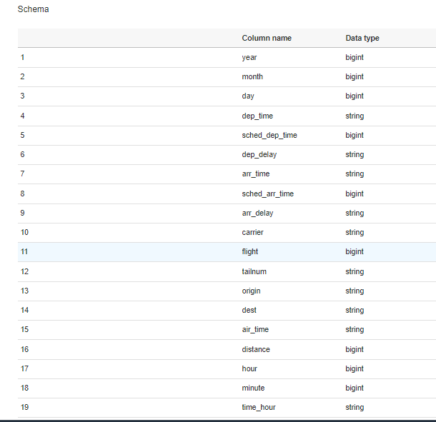
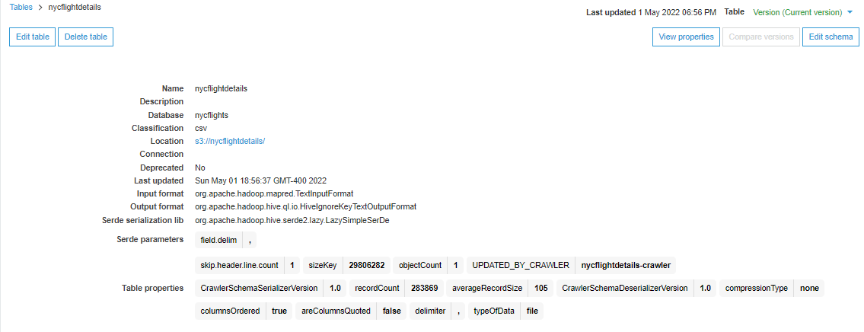
Nycflightdetails: Table created from flights_data.csv

Slide 12
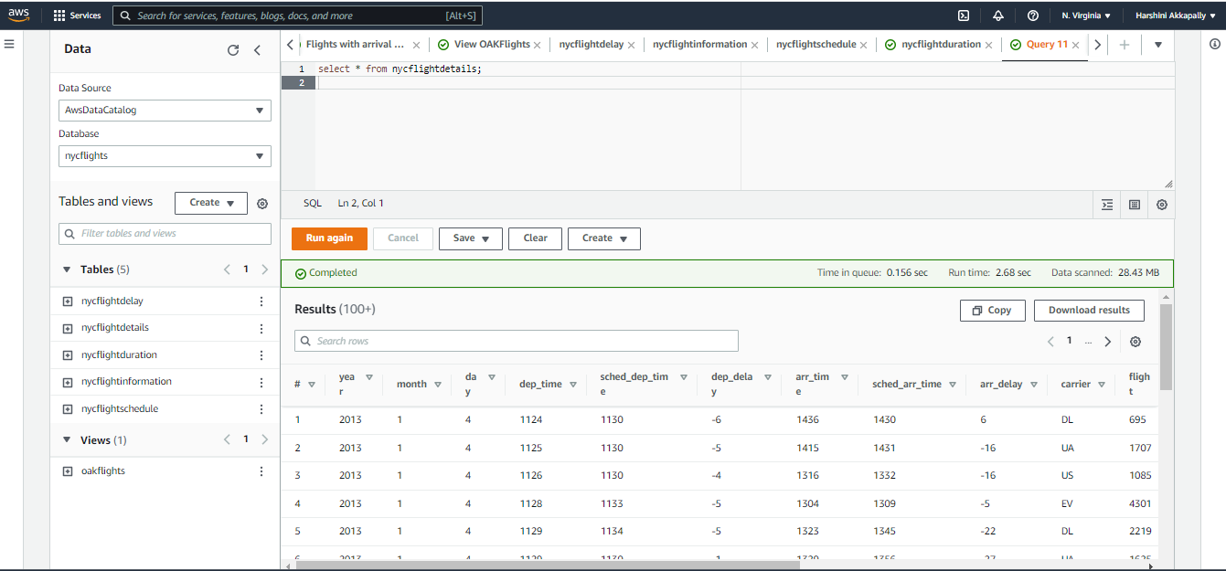

Slide 13
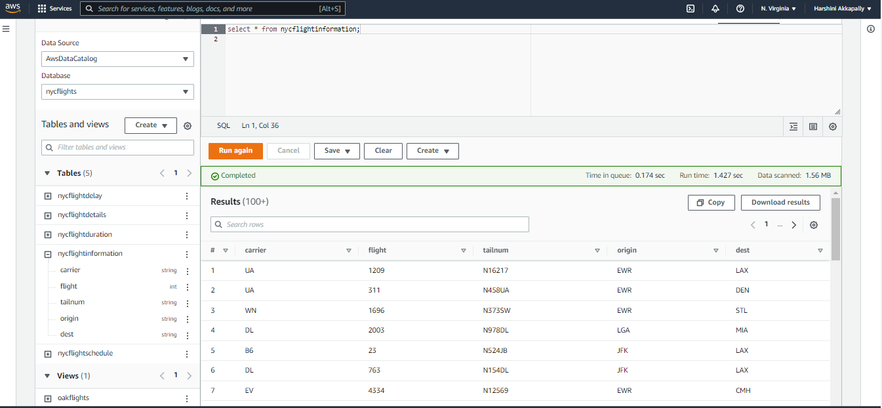
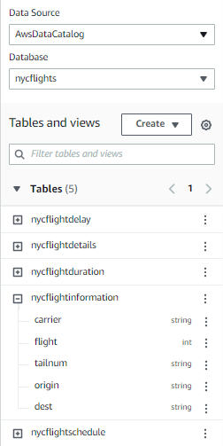
Tables
1: nycflightinformation

Slide 14
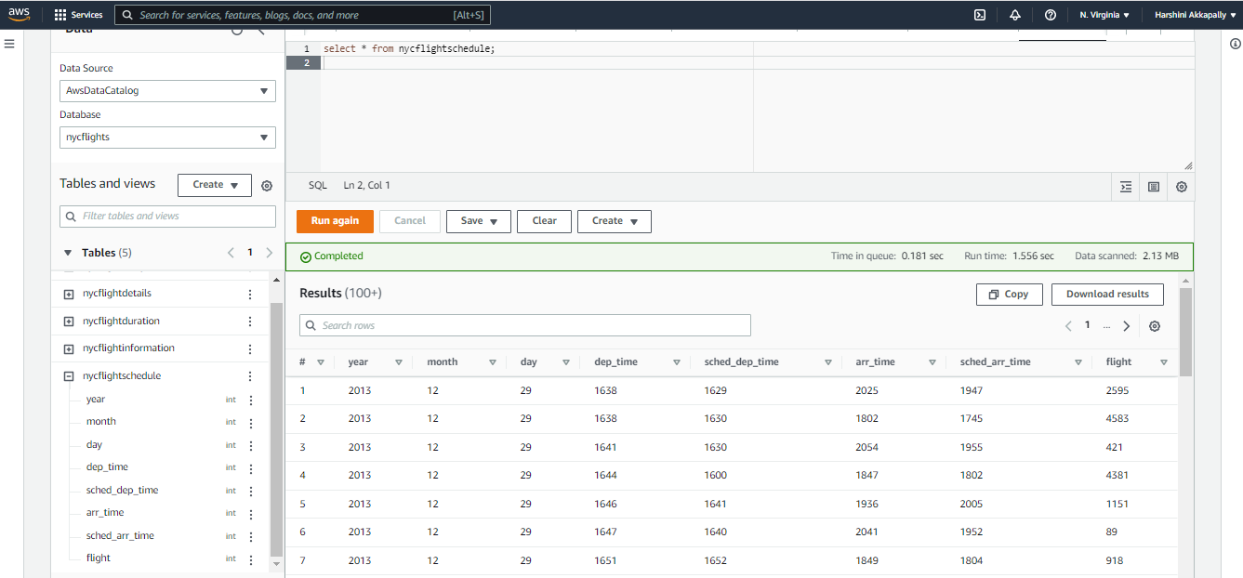
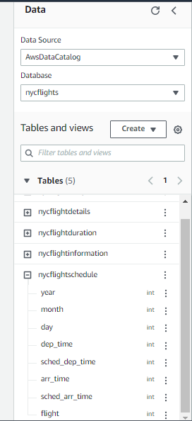
Tables
2. nycflightschedule

Slide 15
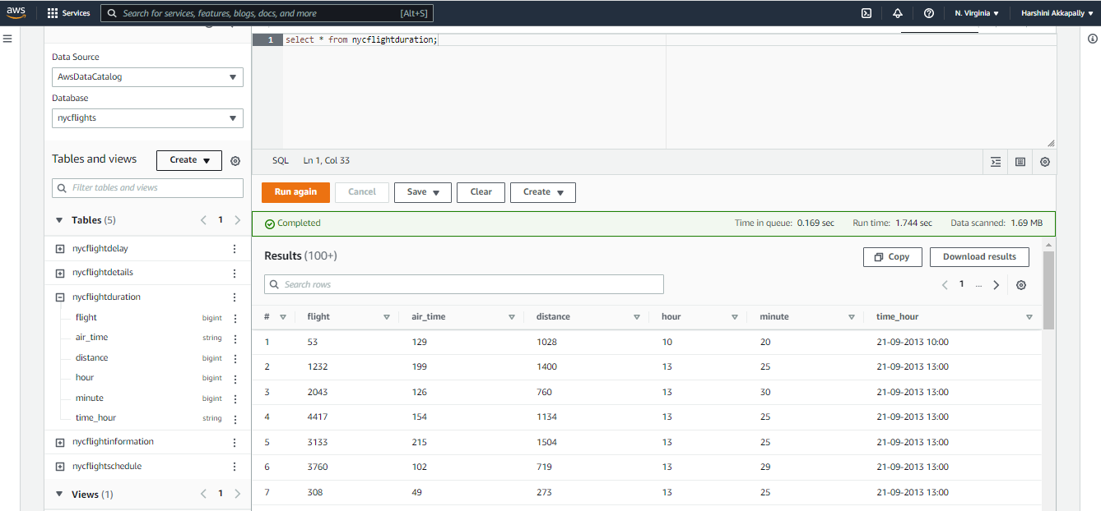
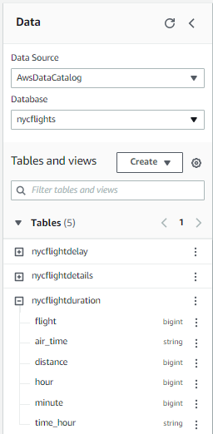
Tables
3. nycflightduration

Slide 16
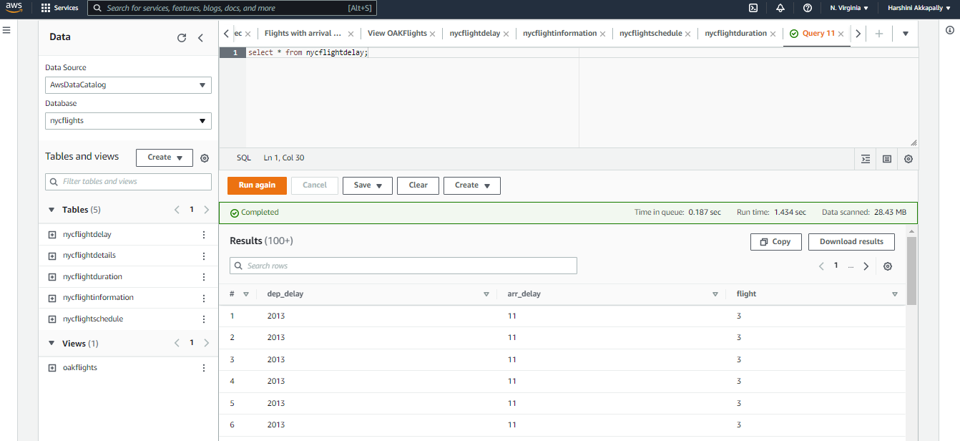
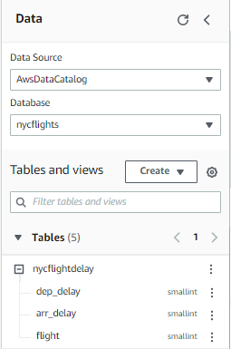
Tables
4. nycflightdelay

Slide 17
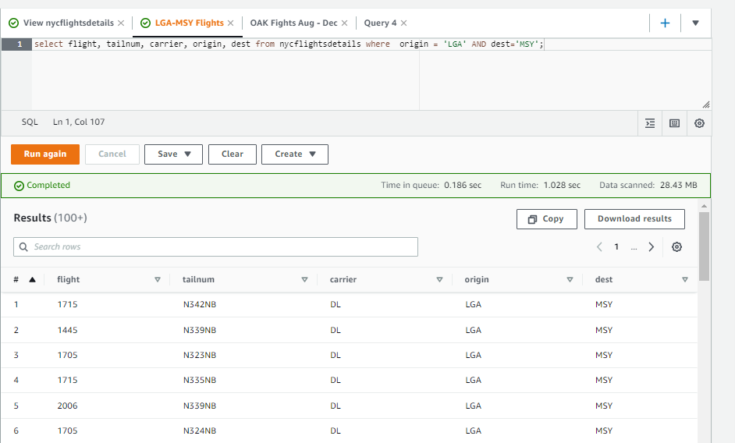
Queries to Analyse Data using SQL
Flights that start from the origin ‘LaGuardia Airport NYC (LGA)’ and go to the destination ‘Louis Armstrong New Orleans Airport (MSY)
select Flight, tailnum, carrier, origin, dest from nycflightdetails where origin = 'LGA' AND dest = 'MSY’;
By this the customers can get the
information on flights that
travel from LGA to MSY

Slide 18
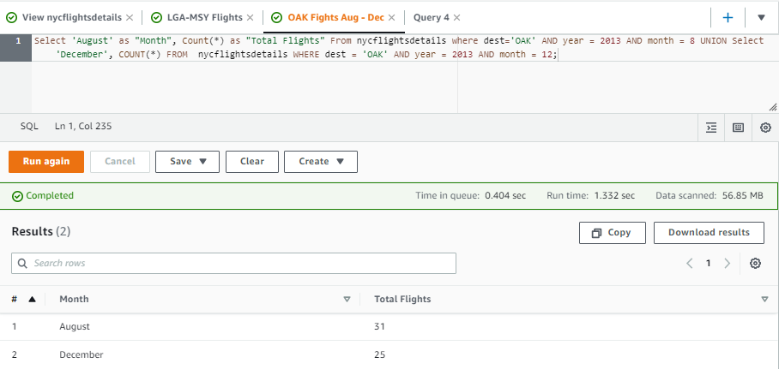
Queries to Analyze Data using SQL
Were there more flights to Oakland in August 2013 or December 2013?
SELECT 'August' as “Month”, COUNT(*) as “Total flights” FROM flights WHERE dest = 'OAK' AND year = 2013 AND month = 8 UNION SELECT 'December', COUNT(*) FROM flights WHERE dest = 'OAK' AND year = 2013 AND month = 12;
By this the customers can decide to travel in
March or August based on the availability
of the flights.
As in August the flights are more,
tickets will be
cheaper

Slide 19
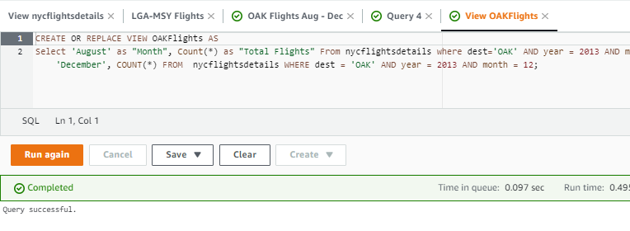
Creating Views
Created a View OAK Flights using Athena:

Slide 20
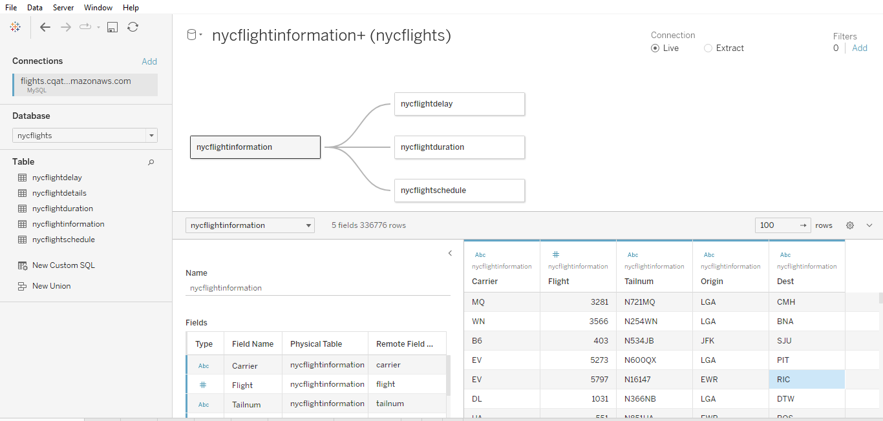
Tableau
Created a connection to Tableau with AWS RDS (Mysql) and imported the tables to Tableau

Slide 21
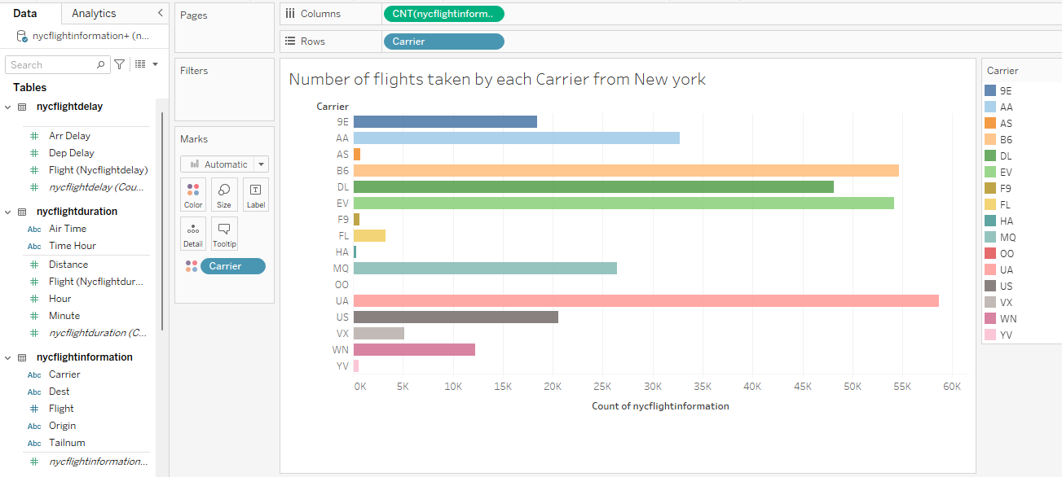
Tableau Visualization
Number of flights taken by each Carrier from New York

Slide 22
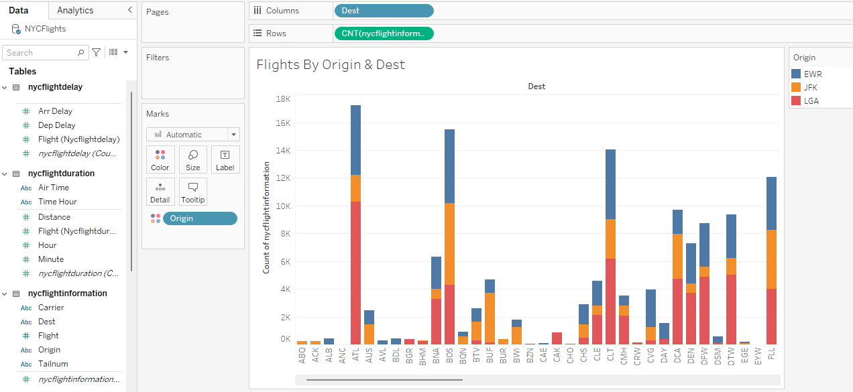
Flights By Origin & Dest

Slide 23
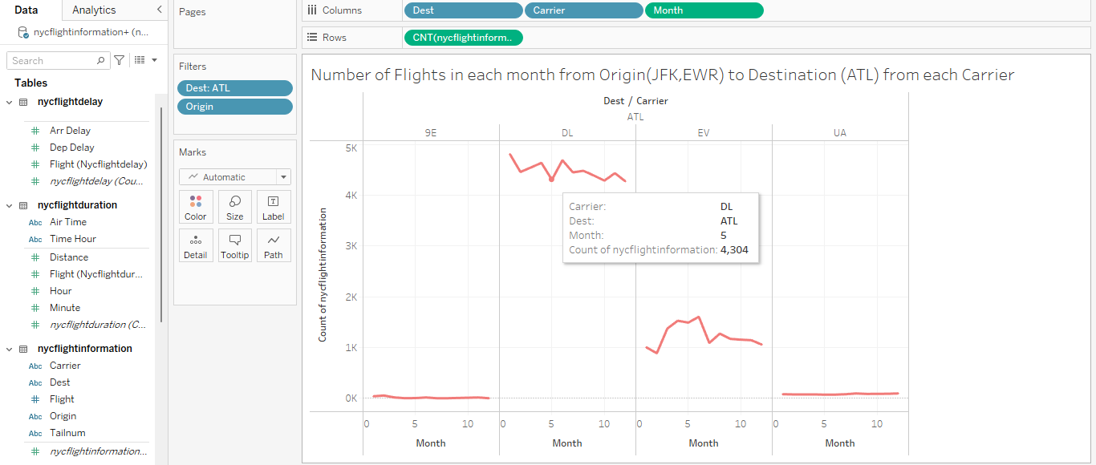
Number of Flights in each month from Origin(JFK,EWR) to Destination (ATL) from each Carrier

Slide 24
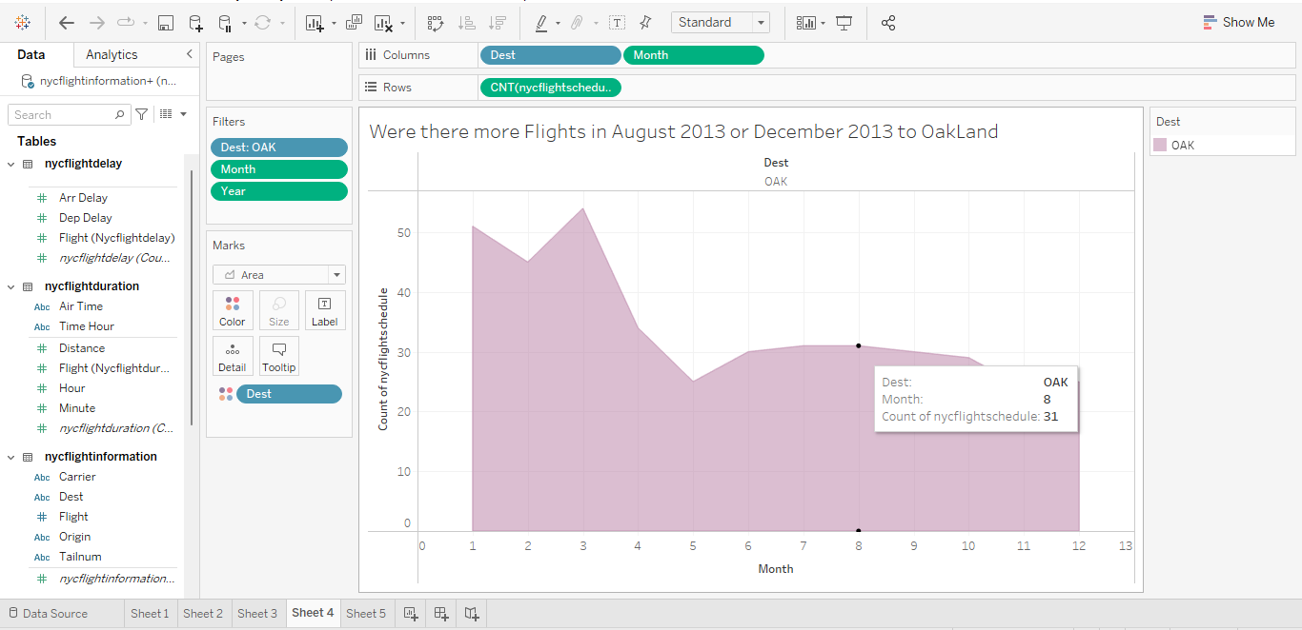
Were there more Flights in August 2013 or December 2013 to OakLand

Slide 25
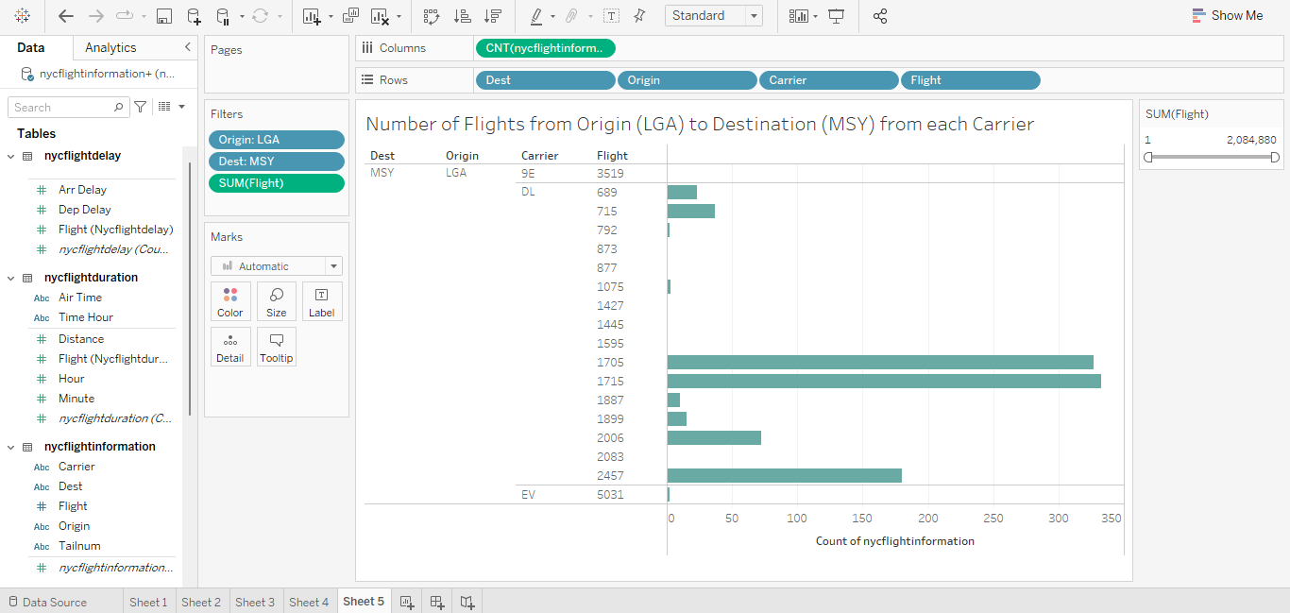
Number of Flights from Origin (LGA) to Destination (MSY) from each Carrier:

Slide 26
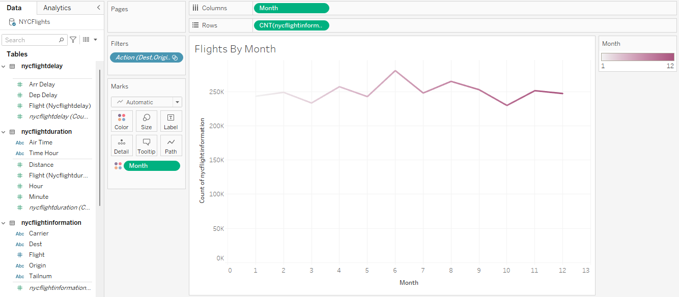
Flights By Month

Slide 27
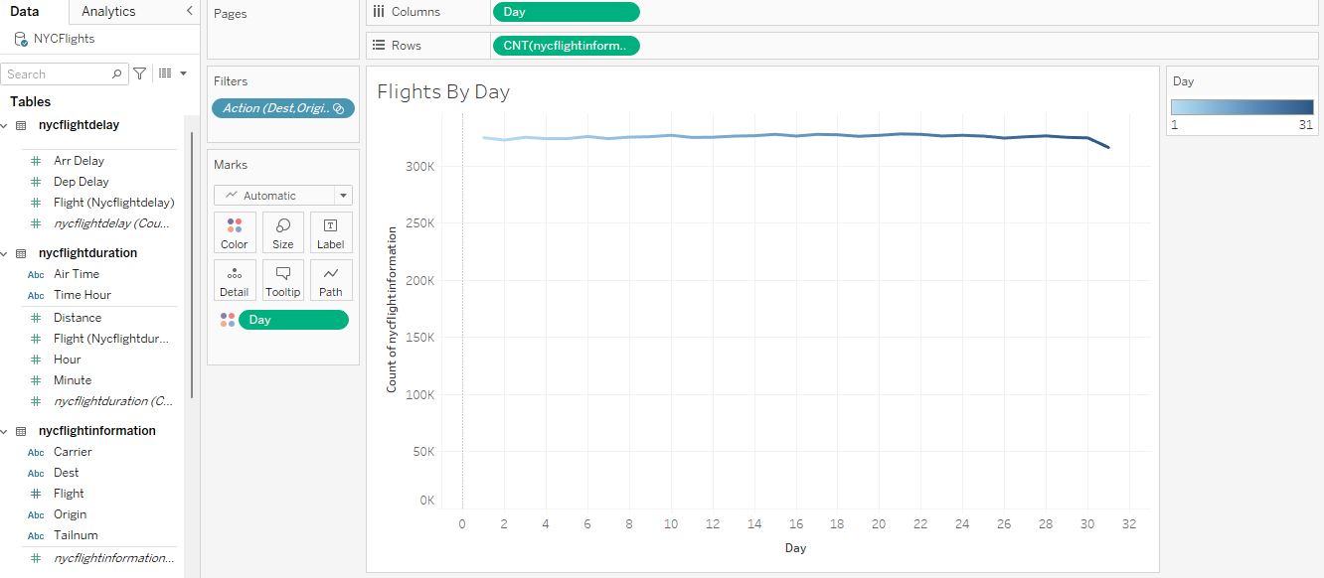
Flights By Day

Slide 28
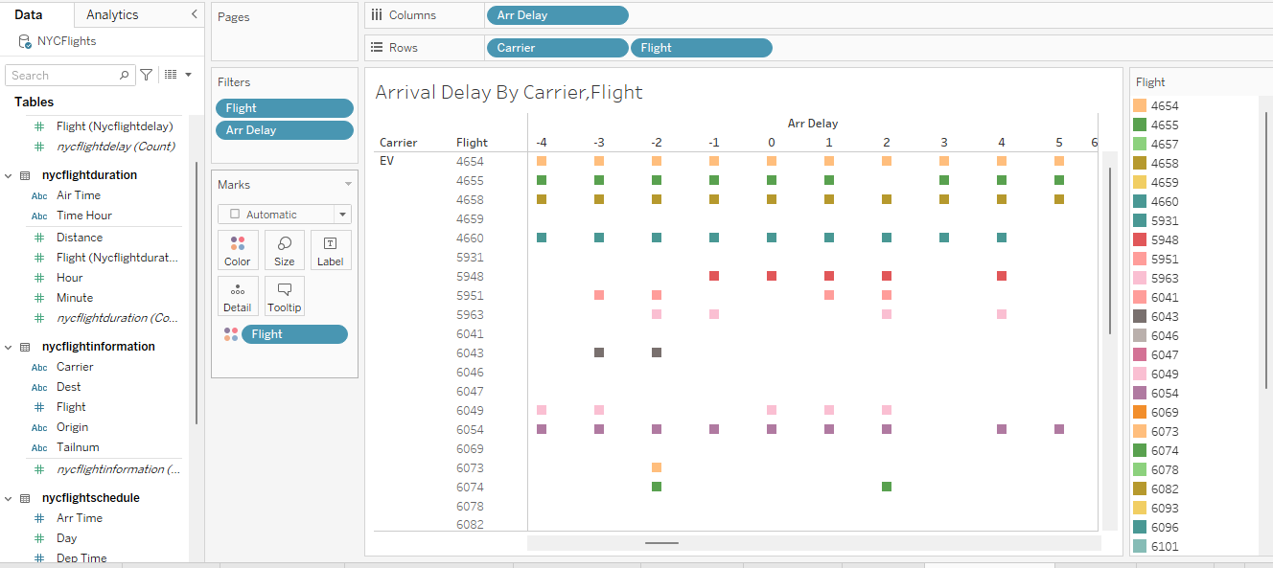
Arrival Delay By Carrier,Flight

Slide 29
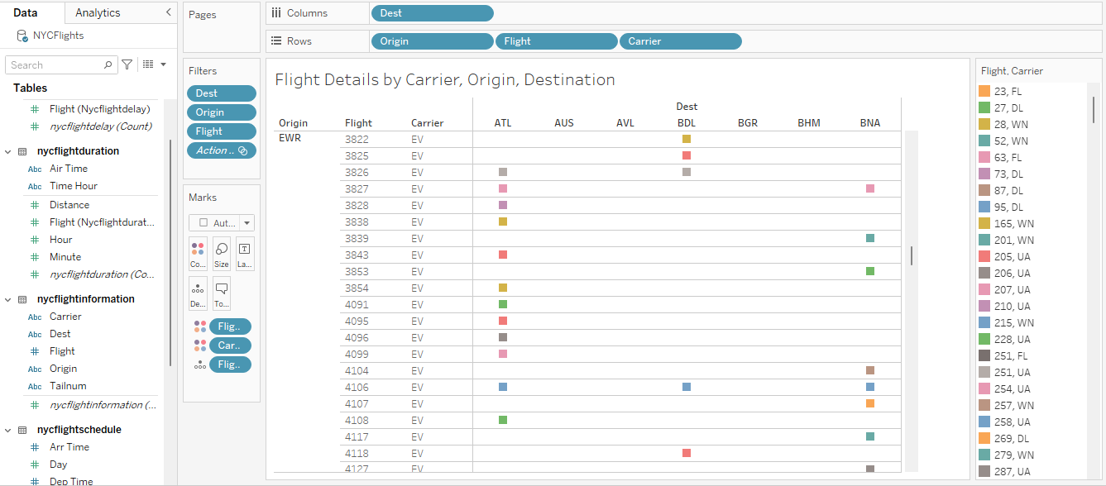
Flight Details by Carrier, Origin, Destination

Slide 30
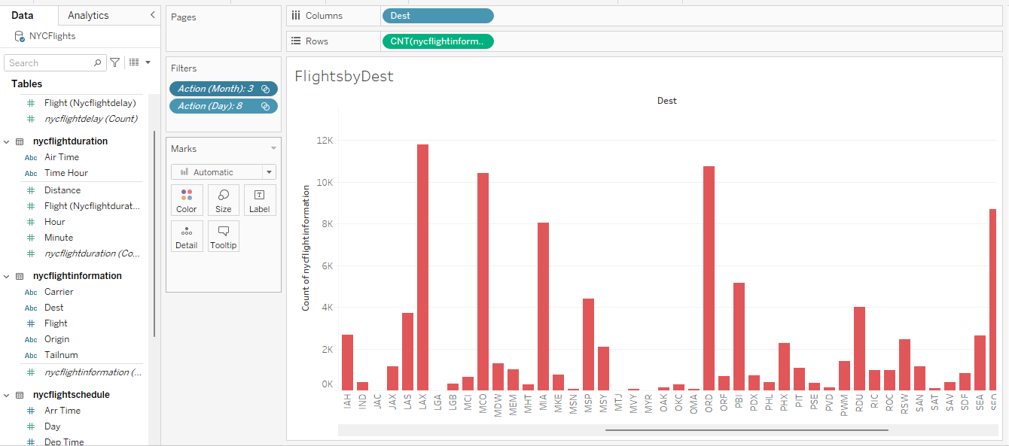
Flights By Dest

Slide 31
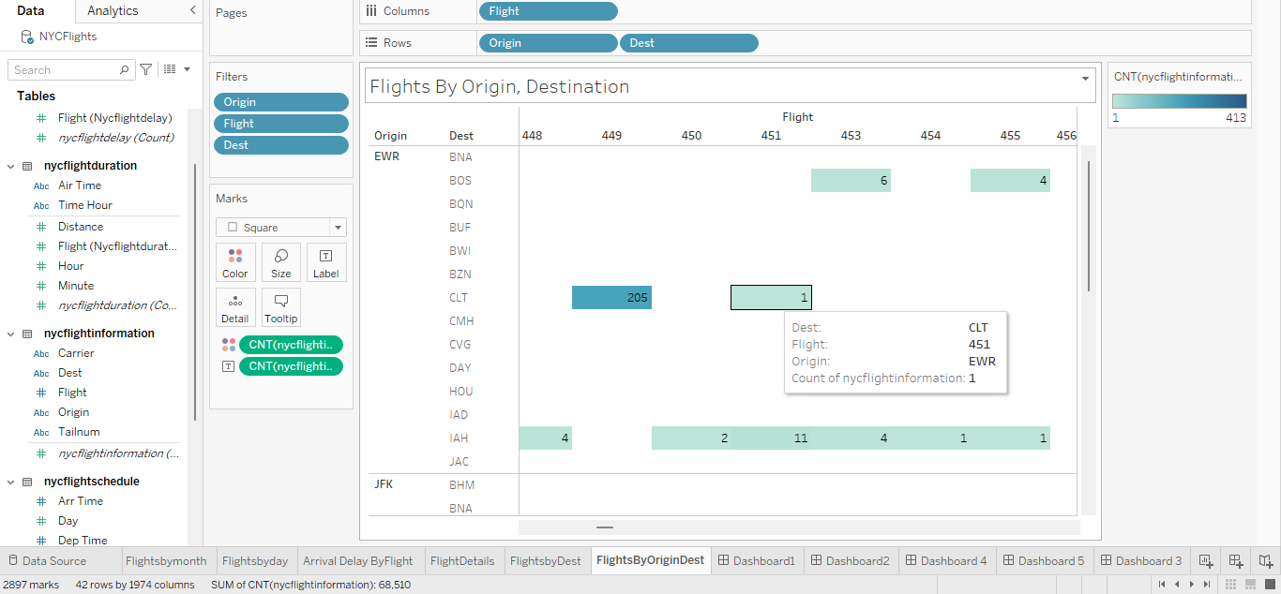
Flights By Origin, Destination

Slide 32
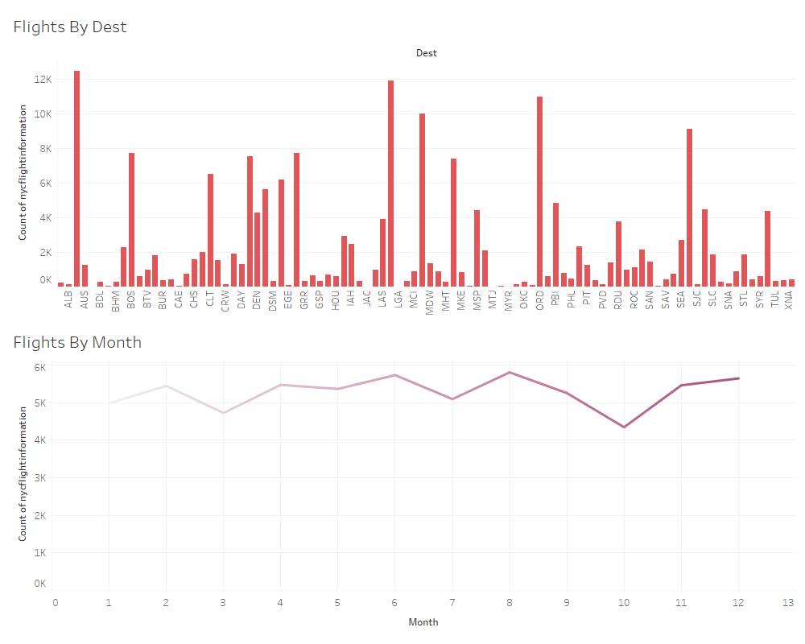

Slide 33
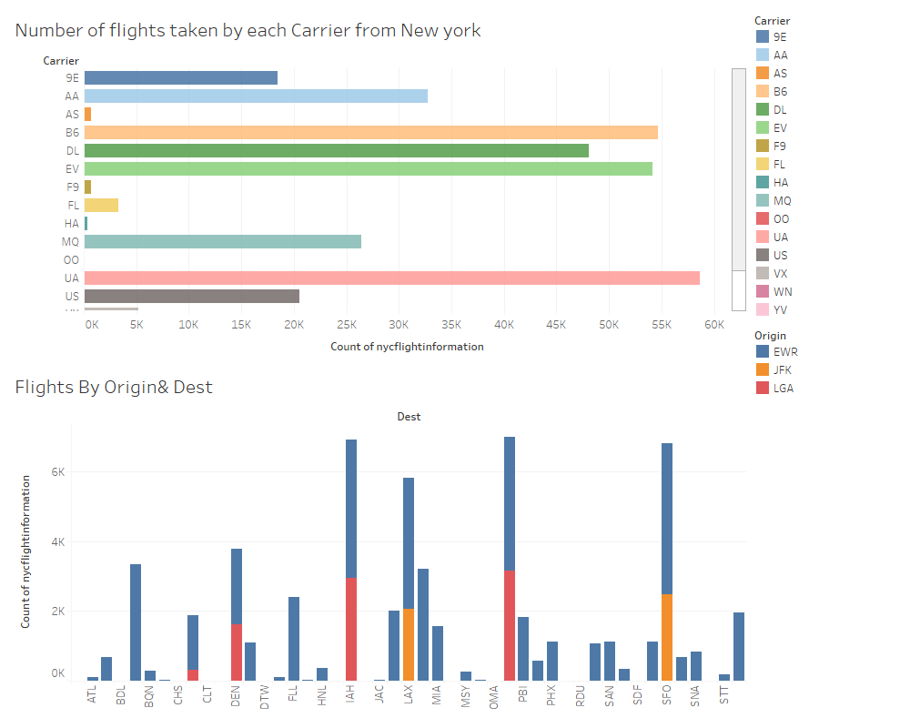

Slide 34
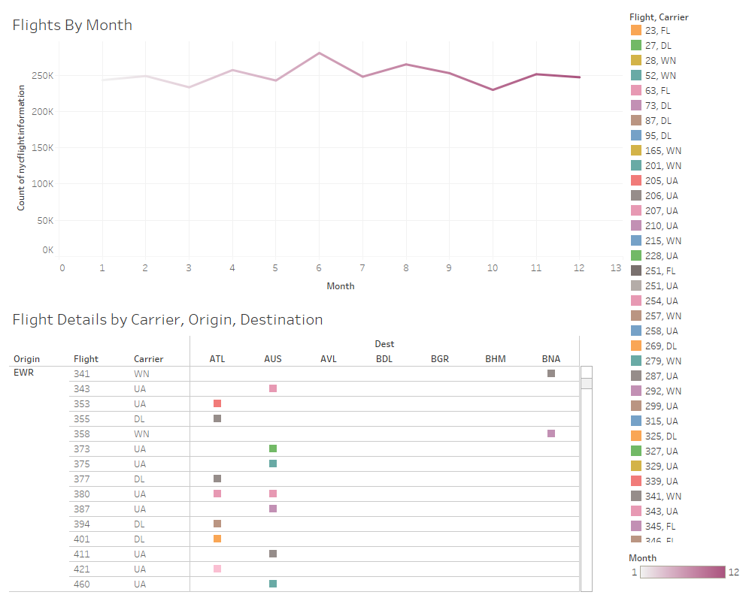

Slide 35
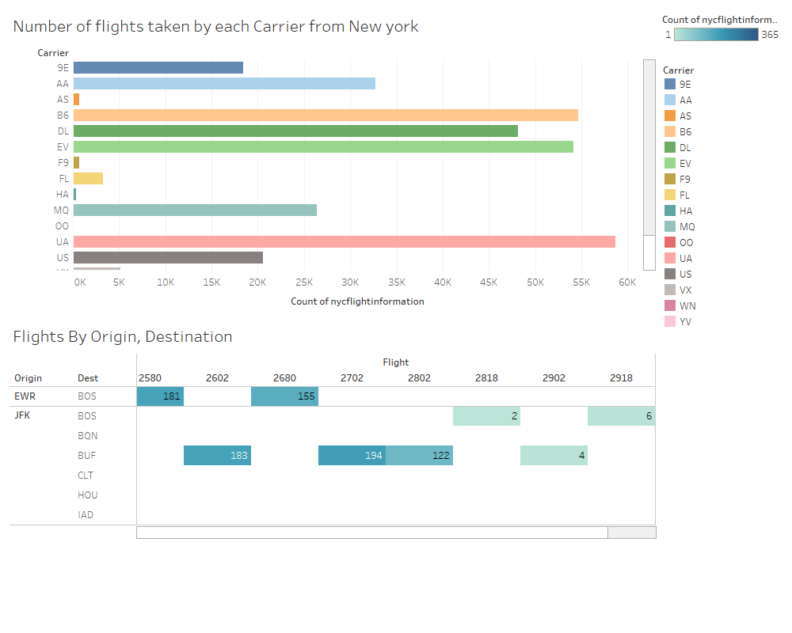

Slide 36
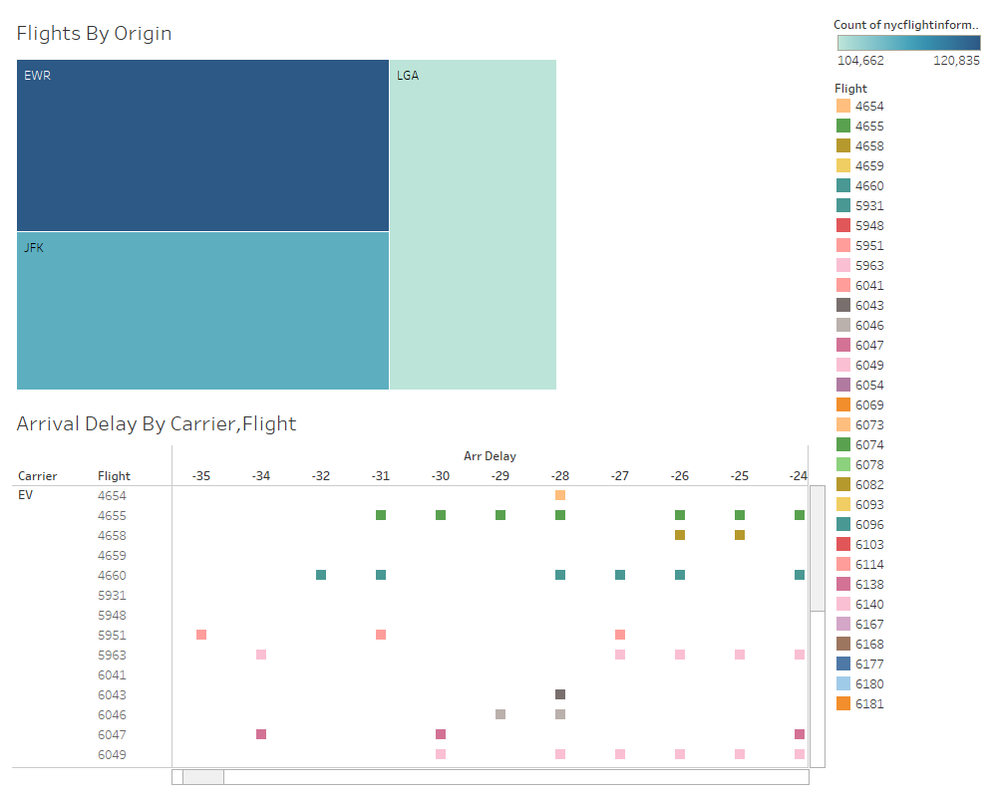
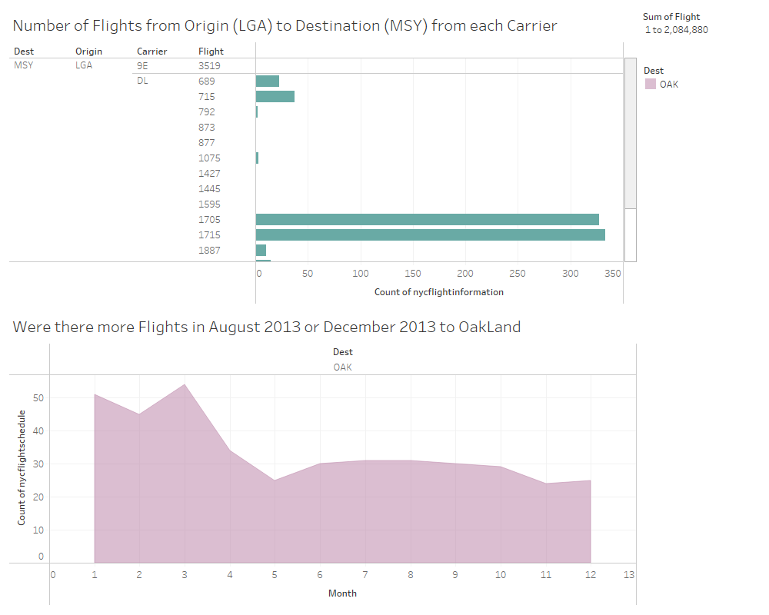

Slide 37
Conclusion
By this Analysis, people can find the flights count and information by carrier, origin, destination by month and day. we could also analyze the arrival and departure delays so that people can avoid taking the wrong flight, avoid delays, which allows them to save time.
Airline management can improve their service by rectifying the arrival and departure delays and also by adding more details like reason for delays, ticket price. This improvement makes an advantage to the people in choosing the best flights to fly.

Slide 38


